Slide 1
SWS-350
Shenzhen Southern Machinery Sales and Service Co.,Ltd
Spesifications:
Model | SWS-350 | Solder pot type | 4th adjustable
PCB width | Max.50~350 | Heating technology | Matrix straight heating, heating efficiency up to 95%
PCB convey height | 750±50mm | Solder pot temp | Room temp.~350℃、accuracy±1-2℃
Conveyor speed | 0-2000mm／Min | Solder pot temp accuracy | ±2℃
Angle | 3~7℃ | Finger types | Strong dicolpate finger/customized
Component height limit | Max.120mm | Solder bar adding way | Manually
Wave height range | 0——18mm keep | Temp. control | P.I.D+SSR
Wave quantity | 2 | Machine control | PLC+PC
Preheating length | 1800MM | Width adjust | Manually/motorized
Preheating zone | ４zones | Flux adding way | Automatically
Conveyor direction | Left to right/right to left | Flux flow rate | 10~100ml/min
Preheat power | 20KW | Spray method | Step motor+A-100 nozzle
Preheat temp | Roomtemp.~250℃ (adjustable) | Flux recycle | Tray to recycle

Slide 2
Shenzhen Southern Machinery Sales and Service Co.,Ltd
Heating way | Hot air | Electricity | 3P 5 wires 380V/3P 220V
Solder bar type | Lead-free | Total power | Max.14kw
Solder pot power | 14kw | Normal running power | Approx.3-8kw
Solder pot capacity | Approx.480kg | Air supply | 0.4MPa~0.7MPa
Solder pot material | Cast iron | Dimension | 4500*1600*1730
Weight | Approx.1500kg
Machine cover
Structure | Streamline cover design, the frame is made of thick square tube, the cover is made of 2mm steel plate. There are totally 6 wheels to move the machine easily.
Front door structure | Fully enclosed glass door, transparent，pneumatic holder to support, ensure the operating and repairing space.
Machine top | Anti-explosion lamp
Surface treatment | Painted with white color
Flux spraying
Spray nozzle | Spray range:20~65mm,adjustable，nozzle height: 50~80mm adjustable，max. flow rate:100ml／ min
Air circuit | Acid and alkali resistant air pipe, the brand is SMC from Japan.
Nozzle moving system | Step motor to drive, Mitsubishi PLC, with proximity switch and entrance sensor to control, according to the coming PCB’s speed and width, the spraying system can detect and starts to work.
Flux recycle system | Tray to hold the waste water and flux, can be draw out easily, make maintenance very convenient.
Flux exhaust system | Exhaust system：stainless steel mesh frame+ double layers filter，recycle the flux to maximum.
Isolated air curtain | Air pressure type knife, blow the redundant flux into the recycling box, to avoid the flux to enter into the preheating zones, ensures the safety.
Spraying box structure | Made of full stainless steel, easy to clean and repair. Anti-corrosion, very durable.
Preheating
Four-stage preheating zone | Preheating length is 1800mm, divided into 4 sections, supply abundant adjusting space, very good for big PCB and complicated PCB. Reduce the heat impact on PCB, improve the production efficiency.
Temp. control method | Mitsubishi temp. collecting module, PID is very precise and stable.
Heating parts | The heaters are imported from Taiwan, heat up very fast, with long life, small thermo lag; The heat is even in the zones.
Preheating power | 20kw
Install mode | The heating module adopts drawer design, easy to replace and repair, make the maintenance very convenient.

Slide 3
Shenzhen Southern Machinery Sales and Service Co.,Ltd
Preheat box cover | Adopt arc streamline design, filled with imported Sisle high-density rock wool to enhance thermal insulation effect
Transmission
Rail | Made of aluminum, wear resistant and without distortion.
Rail parallelism | Width adjusting accuracy less than 0.2mm
Width adjust | Manually/motorized
Transmission Professional Double hook | Special 1.5MM double hook(no deformation, non-stick tin), the thickness of the splint is ≦ 2.5mm (the incoming plate is connected by a synchronous chain)
C/V speed setting unit | Min.1mm／min 0-1800mm／min
C/V speed variation range | Electric closed-loop control, within 0-10mm／min
Conveying motor | Panasonic motor from Japan
Solder pot
Solder pot features | Wetting nozzles with special structure (50-400mm), flat wave design, and tin feeding method is bottom feeding method, which can reduce the oxidation of solder joints, and the oxide slag will automatically gather, which is convenient for maintenance, and does not produce floating tin slag black powder.
Low oxidization design | High quality solder pot, the heat is very steady. Adopts liquid solder flow design, reduce the impact oxidization, especially for small PCB.
Economical running | Reduce the power consumption
Moving method | Motorized
Wave adjustable height | 0-18mm
Wave motor | TCG motor from Taiwan，adjust the wave height with frequency conversion.
Preheating parts | Adopts the stainless steel heaters from Taiwan, with long life and power saving up to 40% daily.
Cooling
Cooling method | Adopts high power centrifugal fan, reduce the air bubble and solder pad stripping
Automatic finger cleaning
Imported premium pump, can wash the fingers from both side. Propyl alcohol to clean and can be recycled.
Control software
★Automatic alarm function for failure:：thermocouple abnormal，temp. too high or too low；if preheating system or solder pot is abnormal,the heating stops.

Slide 4
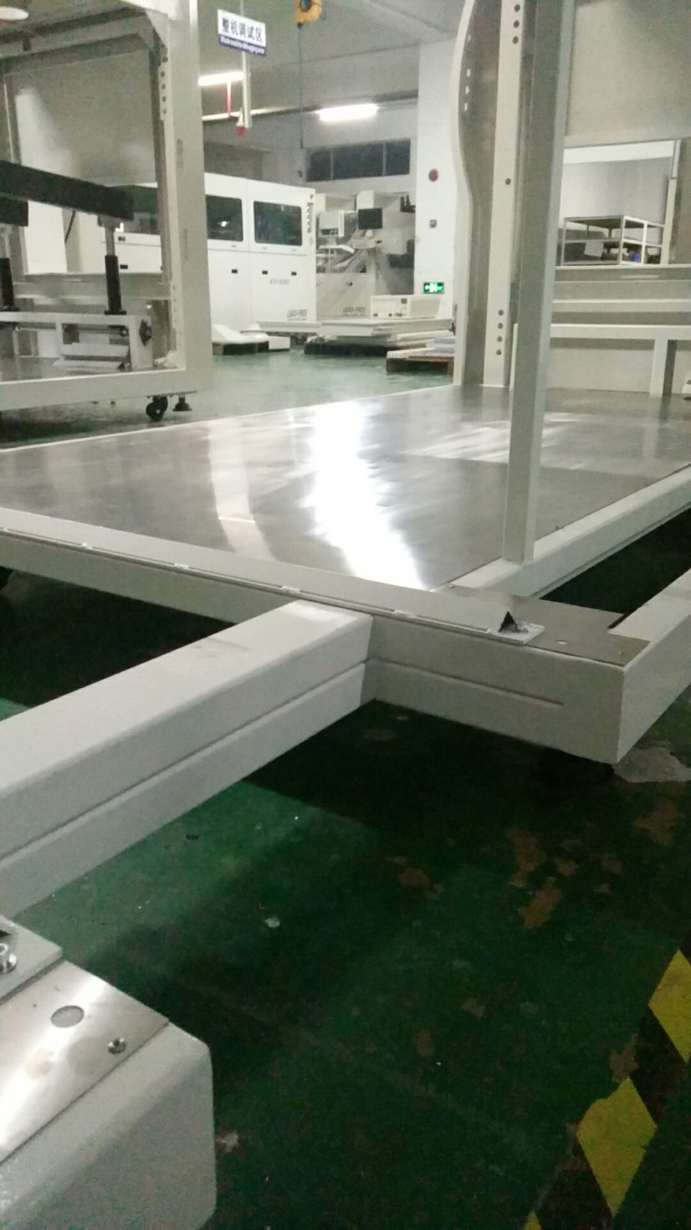
Shenzhen Southern Machinery Sales and Service Co.,Ltd
★Preheating temp., solder pot temp., conveyor speed, spraying and cooling can be controlled separately.
★One week automatic power on/off setting （three times one day）
★The emergency stop are in front, rear of the machine, press them in case of any emergency.
chassis design
The chassis adopts 120x60X5 double-layer superimposed welding to avoid various machine failures caused by the deformation of the frame chassis during the long-term use of the machine.

Slide 5
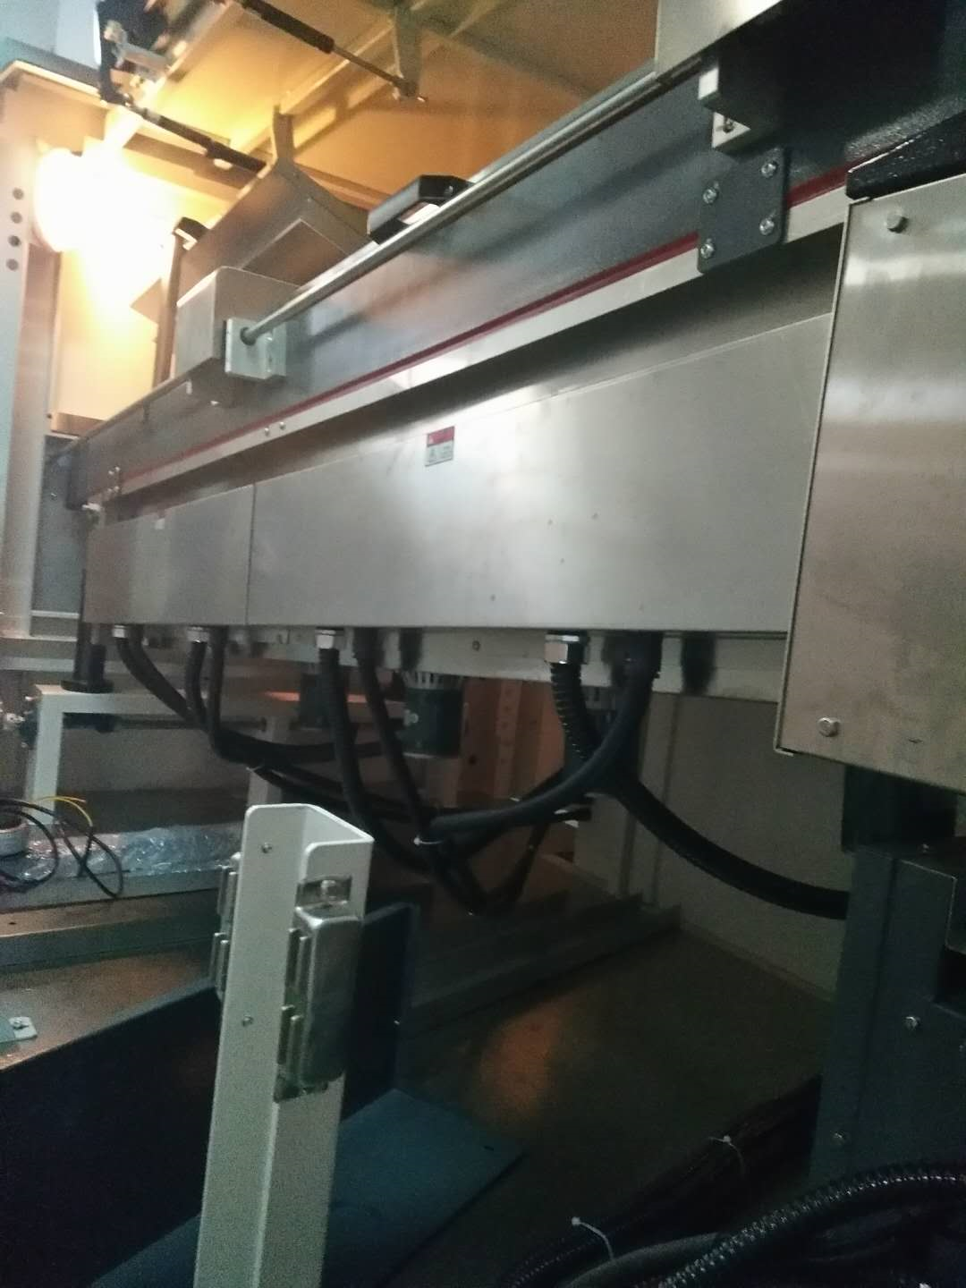
4 full hot air zones
The preheating zone adopts 4 full hot air zones. Other companies generally use 1-stage infrared and 2-stage hot air, totaling 3 stages. The activity of the flux is similar to that of reflow soldering, and a preheating curve is required. Insufficient, the flux activity is not enough, the pass rate is seriously reduced, the repair welding is increased, the labor cost is increased, and the quality is affected. Stainless steel parts, on the other hand, last many years longer than the cold plate dusting process, and there is no risk of paint peeling and rusting.

Slide 6
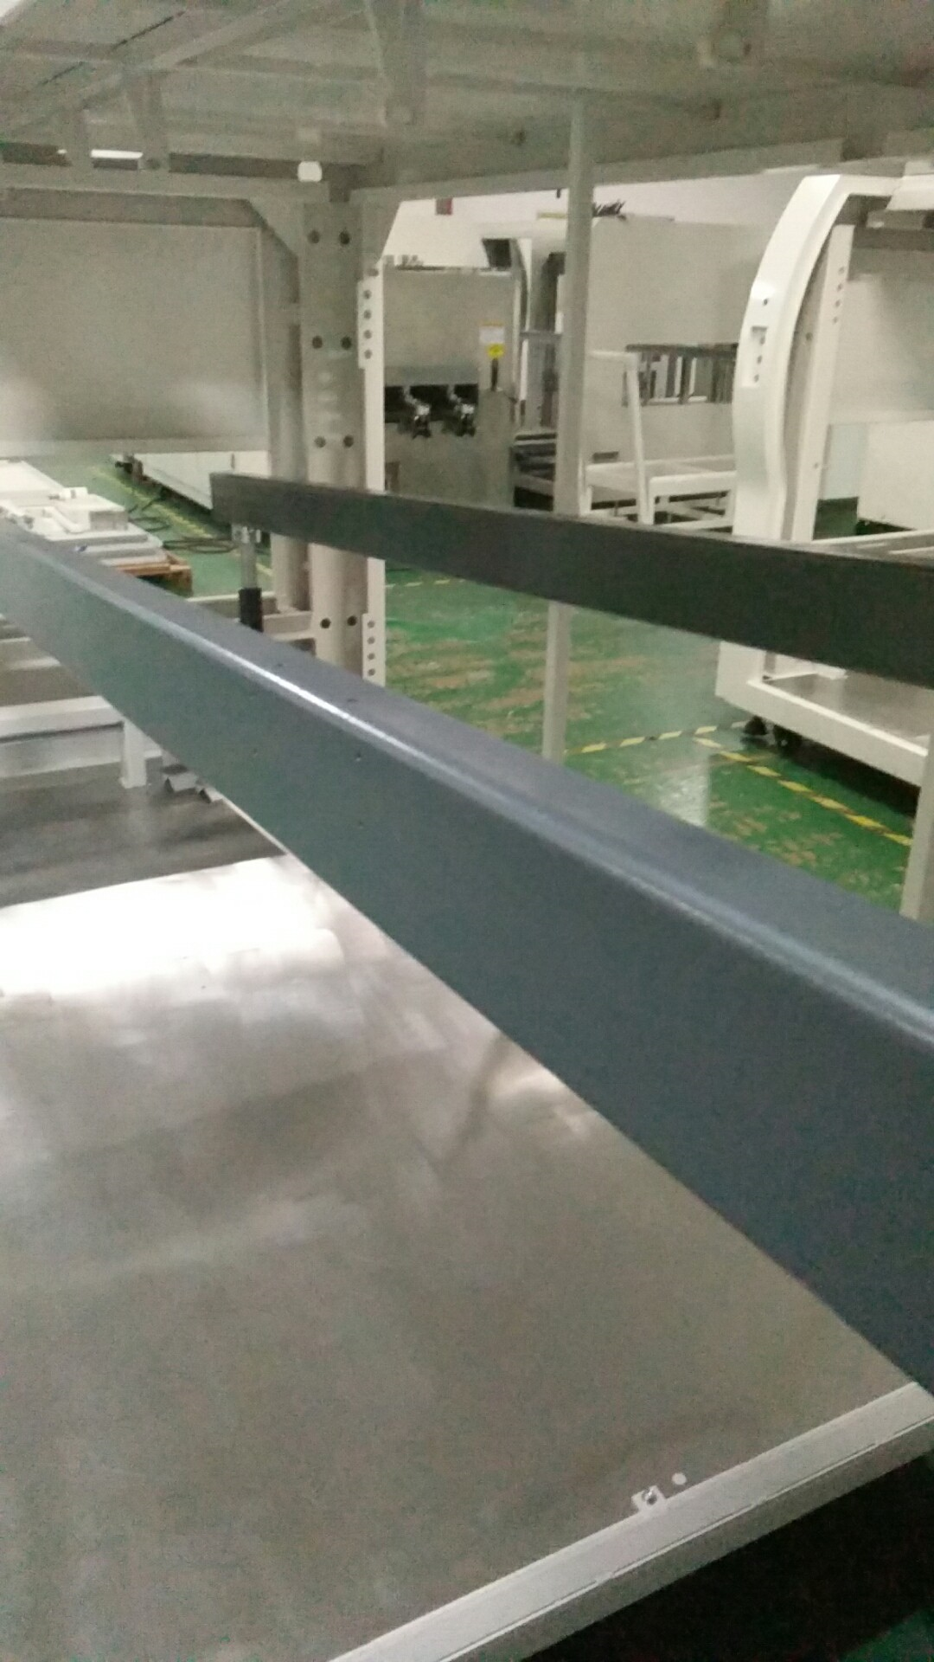
Dewatering precision cast steel
The main track of the preheating zone is made of 120x60x5 dewatering precision cast steel, which is not deformed or shaken. But at present, most companies use only 80X40X4 precision cast steel in order to save costs.

Slide 7
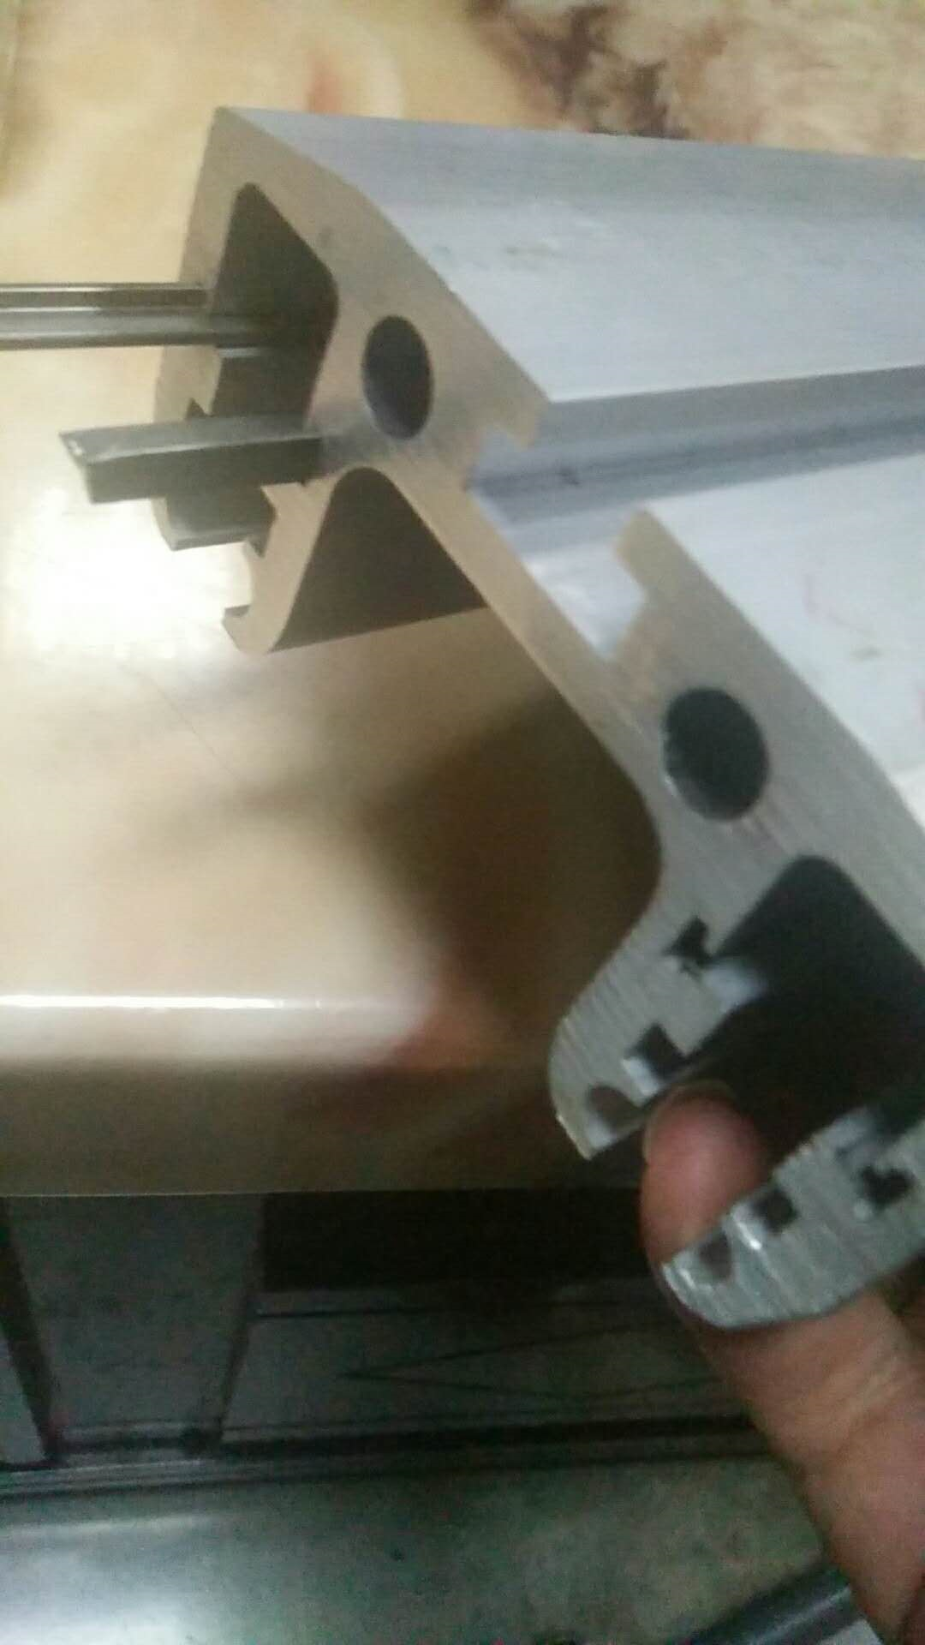
Rail material
The transport guide rails are made of the first-quality Shenzhen Huajiari 7 series profiles of aluminum profiles. The SMS350 uses carbon steel chains to slide on the steel bars, which are not easy to wear and increase the service life and stability of the machine.

Slide 8
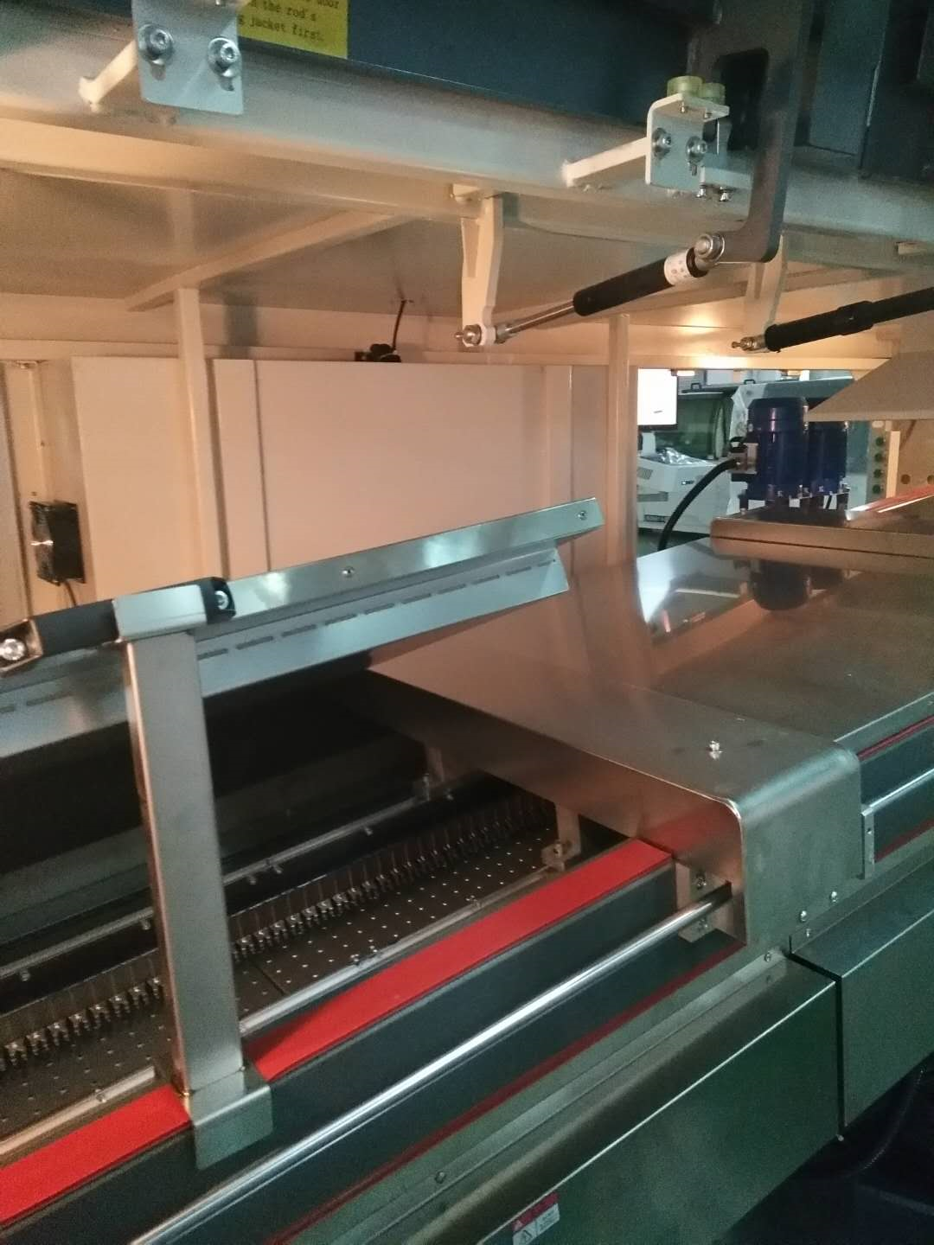
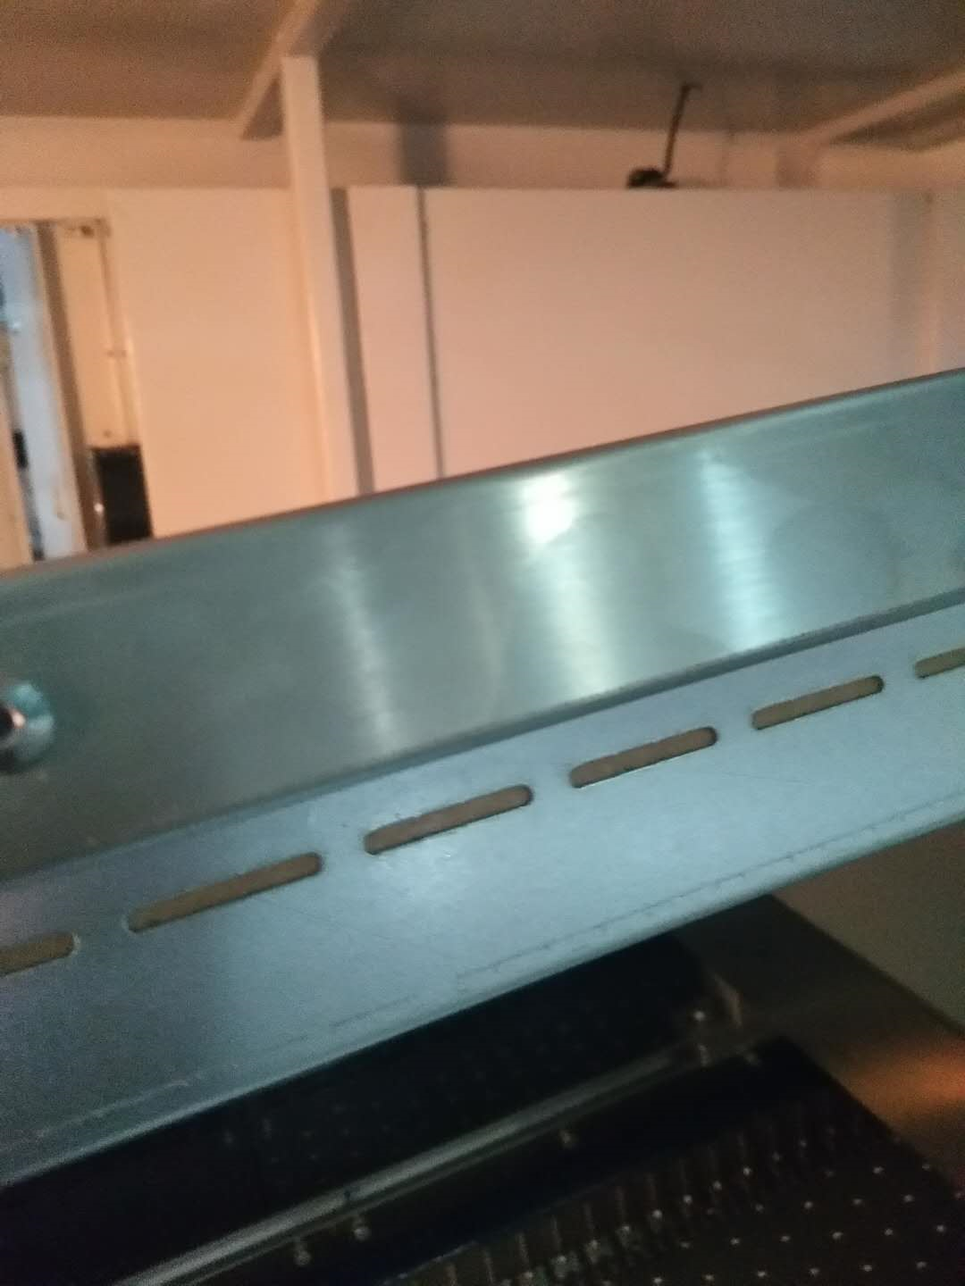
Stainless steel preheat cover
The preheating cover adopts an all-stainless steel structure, three layers of thermal insulation cotton, and the heat sink is interrupted between the hot and cold, which saves electricity and keeps heat, so as to achieve energy saving and environmental protection.

Slide 9
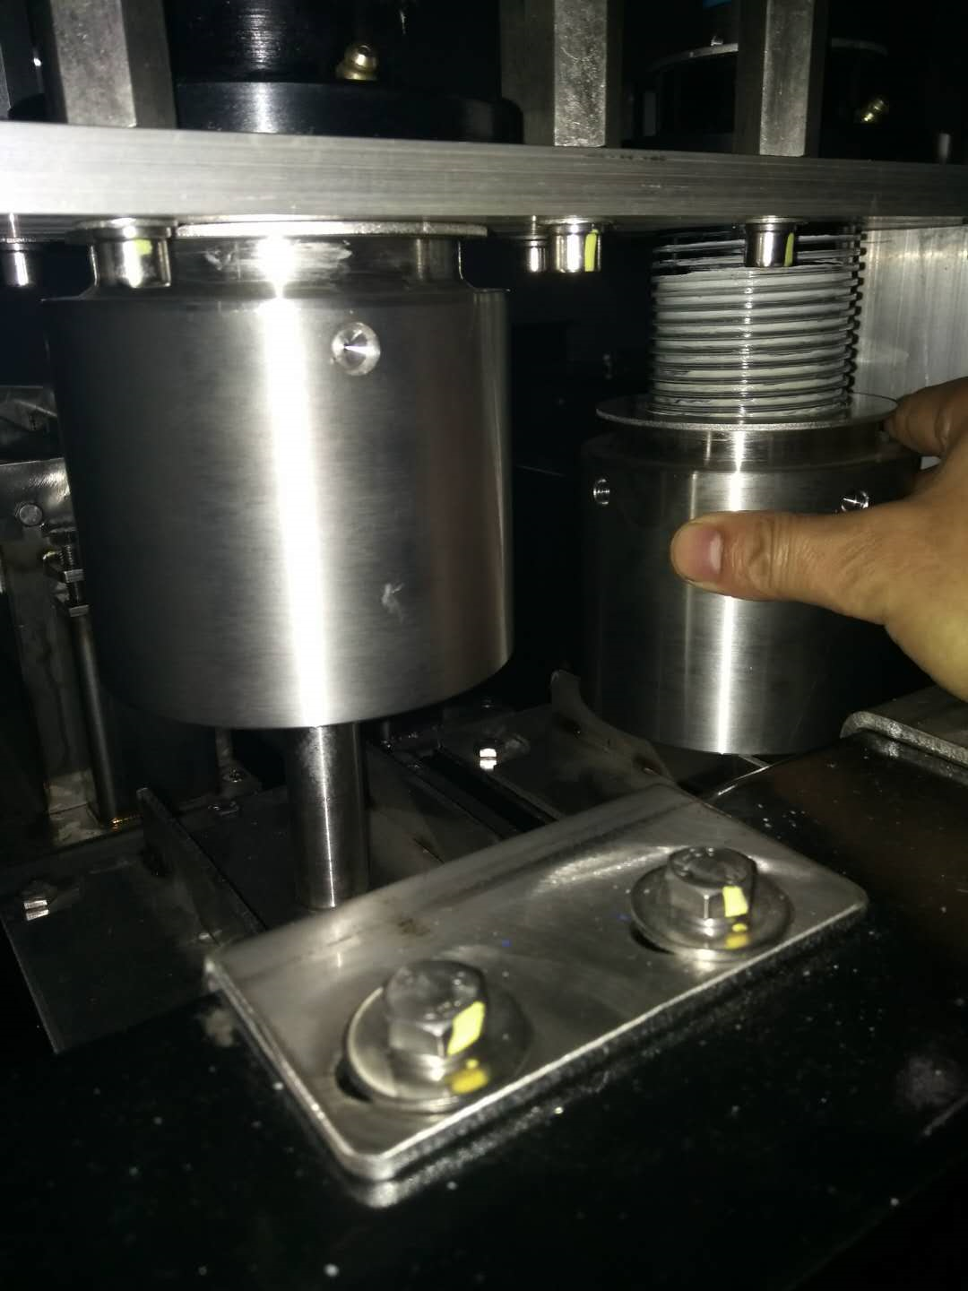
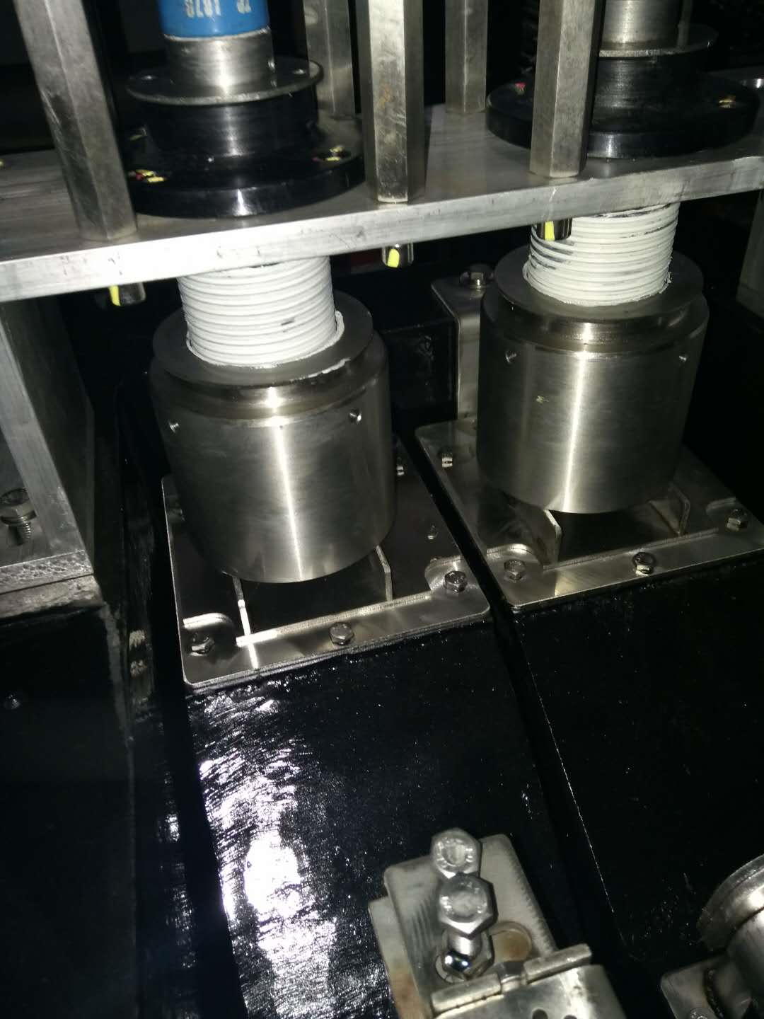
The anti-oxidation sleeve of the tin furnace adopts the nut convenient disassembly type, because usually if the motor is stuck, it takes 4 to 6 hours to clean the tin furnace, resulting in shutdown, and if the motor of the anti-oxidation sleeve is stuck, it only takes 10 minutes to complete the process. A stuck oxide sleeve is an ever-present fault in wave soldering. It may not be equipped, but it produces oxidized waste every day, which is not recyclable.

Slide 10
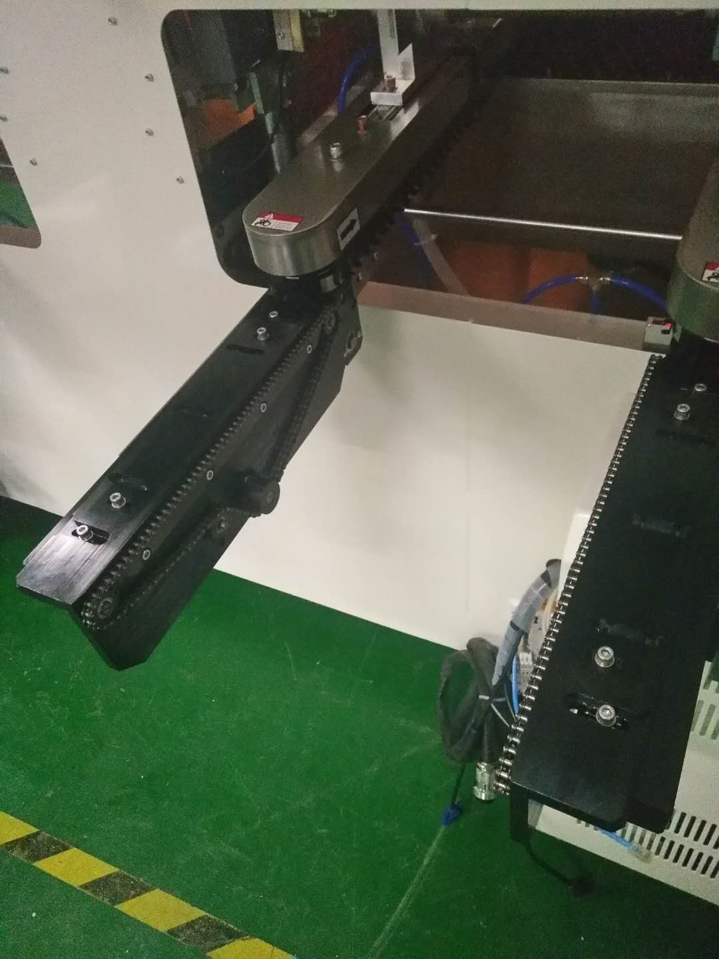
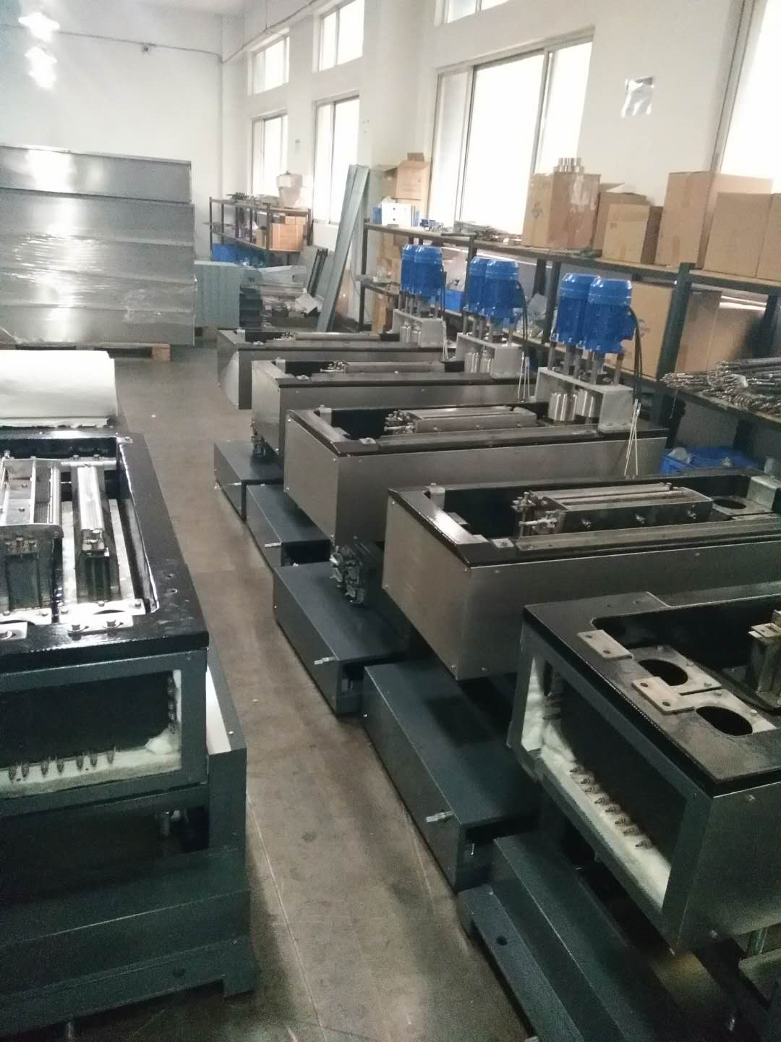
Taiwan songyi structure into the plate, into the plate is very smooth, easy to adjust, tin furnace using nodular alloy, nozzle using titanium alloy.

Slide 11
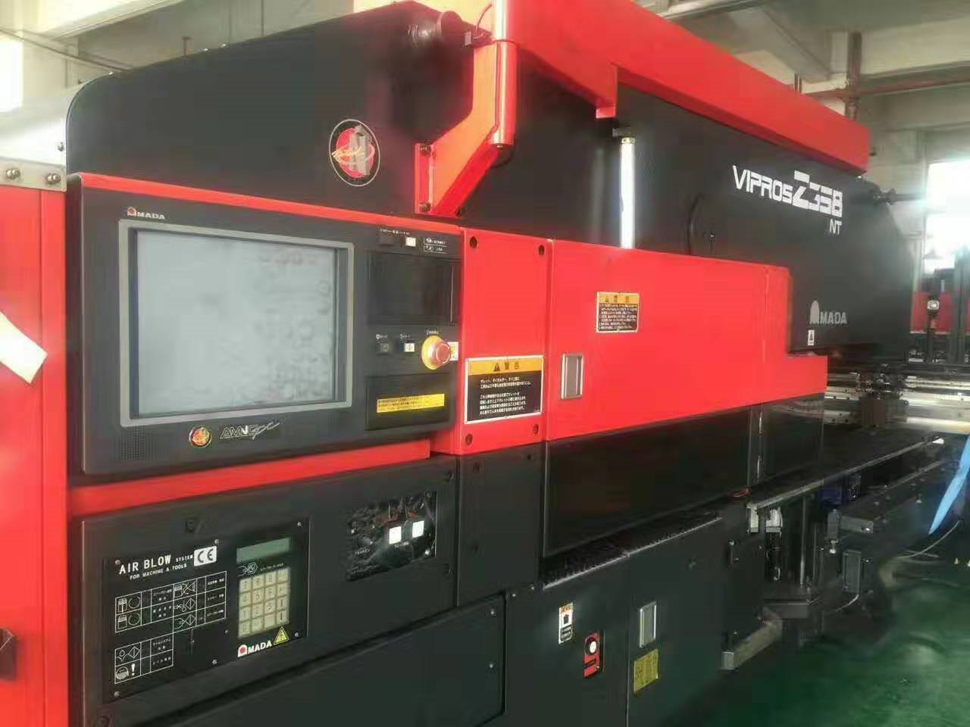
Part of the processing equipment

Slide 12
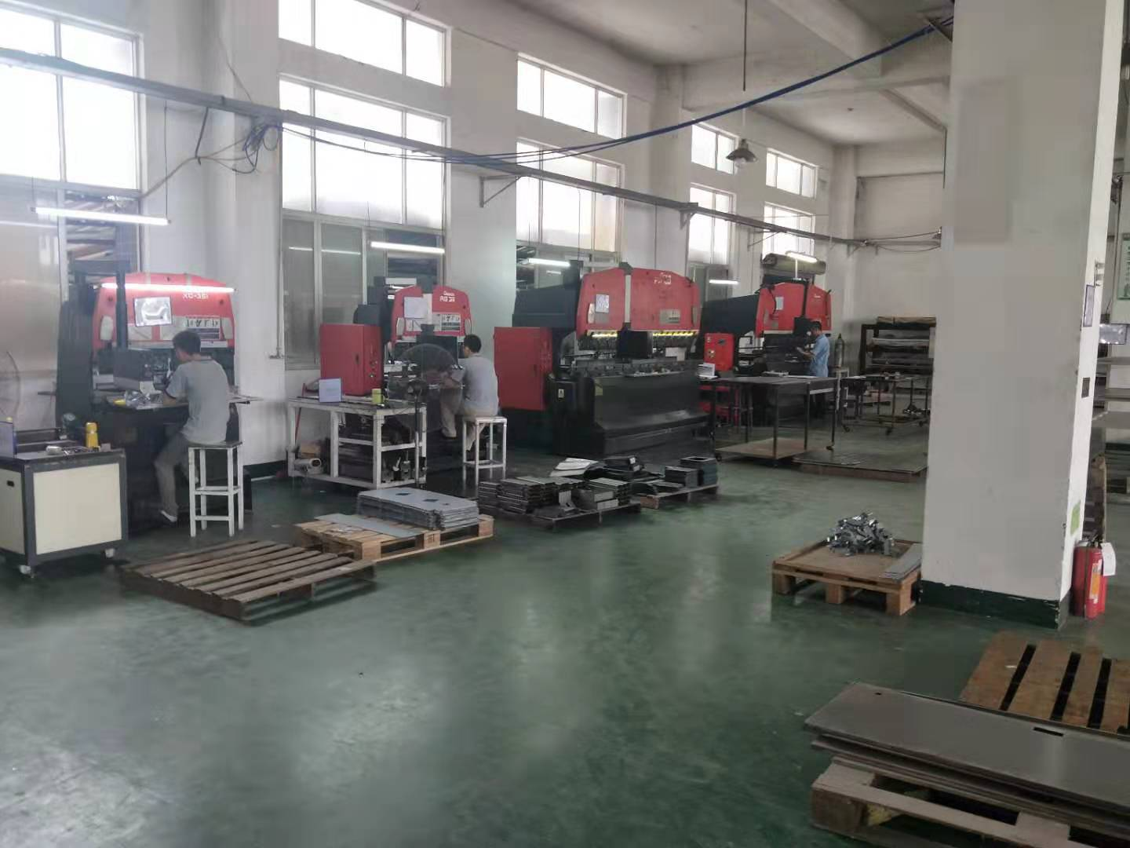
Part of the processing equipment

Slide 13
Welcome inquiry
1,Please visit : www.smthelp.com
2, Find us more: https://www.facebook.com/autoinsertion
3, Know more our team: https://cn.linkedin.com/in/smtsupplier
4, Welcome to our factory in Shenzhen China
5, See more machine working video, please Youtube: Auto Insertion
6, Google: Auto+insertion, to get more informations
7,Looking forward to your email:info@smthelp.com

